Slide 1

ME 200 Thermodynamics
Lecture 10 – Closed System Examples

Slide 2
Where does the energy go?
A gas is contained in a vertical piston-cylinder assembly by a piston with a face area of 0.02 m² and a mass of 40 kg. The atmosphere exerts a pressure of 1 bar on top of the piston. A paddle wheel does 3 kJ of work on the gas during a process in which the elevation of the piston increases by 0.1 m. The system stays in thermal equilibrium with the environment throughout the process.
Where does the energy go if 3 kJ of work was input by the paddle wheel?
To W, Q, U, P.E., K.E.
To W, Q, U, P.E. only
To W, Q, U only
To W, Q only
None of the above
Notes:
2 minutes
D

Slide 3
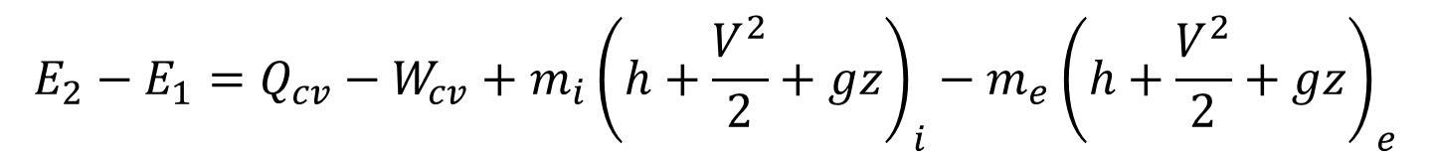
Where does the energy go?
A gas is contained in a vertical piston-cylinder assembly by a piston with a face area of 0.02 m² and a mass of 40 kg. The atmosphere exerts a pressure of 1 bar on top of the piston. A paddle wheel does 3 kJ of work on the gas during a process in which the elevation of the piston increases by 0.1 m. The system stays in thermal equilibrium with the environment throughout the process.
Where does the energy go if 3 kJ of work was input by the paddle wheel?
$$E_{2}−E_{1}=Q_{cv}−W_{cv}+m_{i}{\left(h+\frac{V^{2}}{2}+gz\right)}_{i}−m_{e}{\left(h+\frac{V^{2}}{2}+gz\right)}_{e}$$
$$\left(U_{2}+{PE}_{2}+{KE}_{2}\right)−\left(U_{1}+{PE}_{1}+{KE}_{1}\right)=Q_{cv}−W_{cv}$$
piston
Notes:
PE is negligible
Temperature change so U is not available so in order to stay in equilibrium, the heat needs to be transferred out

Slide 4
Saturated Water?
A saturated water is contained in a vertical piston-cylinder assembly by a piston with a face area of 0.02 m² and a mass of 40 kg. The atmosphere exerts a pressure of 1 bar on top of the piston. A paddle wheel does 3 kJ of work on the fluid during a process in which the elevation of the piston increases by 0.1 m. The system stays in thermal equilibrium with the environment throughout the process.
Where does the energy go if 3 kJ of work was input by the paddle wheel?
To W, Q, U, P.E., K.E.
To W, Q, U, P.E. only
To W, Q, U only
To W, Q only
None of the above
Notes:
2 minutes

Slide 5
Application
Is the net power of typical internal combustion engines affected by the weight of pistons and atmospheric pressure?
Yes, by the piston weight and atmospheric pressure.
Yes, but by the piston weight only.
Yes, but by atmospheric pressure work only.
Neither.
Notes:
1 minute to think

Slide 6
Application
Is the net power of typical internal combustion engines affected by the weight of pistons and atmospheric pressure?
piston
piston
150 bar
Notes:
Significant amount of pressure inside so other stuff is insignificant

Slide 7
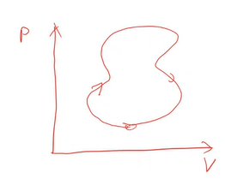
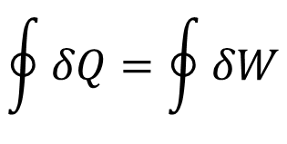
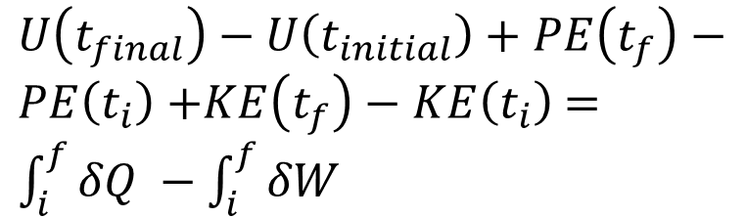
Closed System Operating over a Cycle
A cycle defines a certain type of process path: one in which the end state and the beginning state are the same.
$U\left(t_{final}\right)−U\left(t_{initial}\right)+PE\left(t_{f}\right)−PE\left(t_{i}\right)$ $+KE\left(t_{f}\right)−KE\left(t_{i}\right)$ $=\int_{i}^{f}{δQ }−\int_{i}^{f}{δW}$
$$\oint{δQ}=\oint{δW}$$
Notes:
Then can calculate Q instead of W to find the same thing

Slide 8

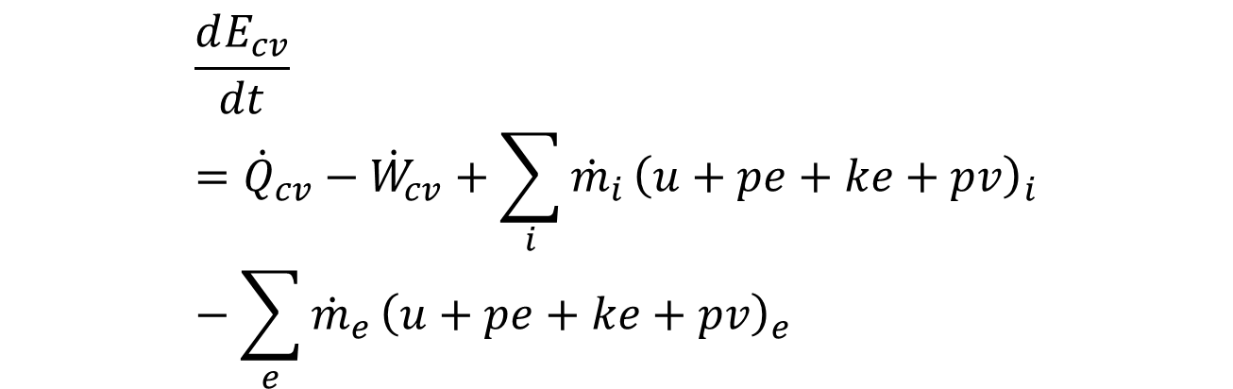
Modes of Energy Transfer
Convective transport
Heat transfer
Work transfer
$$E=U+PE+KE$$
$$\frac{dE_{cv}}{dt}={\dot{Q}}_{cv}−{\dot{W}}_{cv}+\sum_{i}{{\dot{m}}_{i}}{\left(u+pe+ke+pv\right)}_{i}−\sum_{e}{{\dot{m}}_{e}}{\left(u+pe+ke+pv\right)}_{e}$$
Notes:
Pv is the convective heat transfer

Slide 9
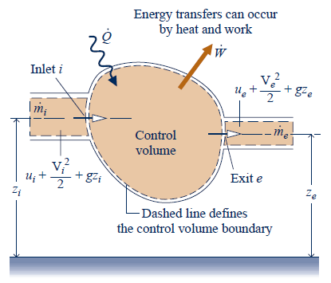
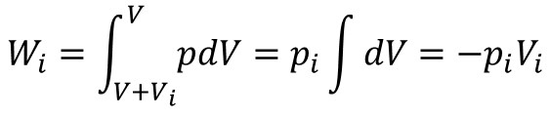



Convective Transport
Whenever there is bulk flow of matter across a system boundary, there is also an accompanying energy transport.
$${\dot{m}}_{i}\left(e_{i}−w_{i}\right)={\dot{m}}_{i}\left(u_{i}+{pe}_{i}+{ke}_{i}+p_{i}v_{i}\right)$$
A
Flow work
$$V+V_{i}$$
$$V$$
$$W_{i}=\int_{V+V_{i}}^{V}{pdV}=p_{i}\int{dV}=−p_{i}V_{i}$$
Flow work rate = $\frac{p_{i}V_{i}}{∆t}=p_{i}v_{i}{\dot{m}}_{i}$
Notes:
Pushing in inlet

Slide 10
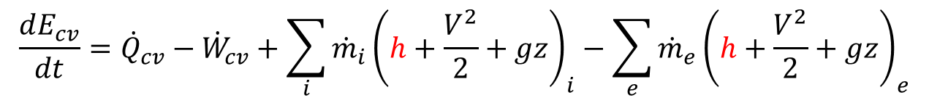

Modes of Energy Transfer
Convective transport
Heat transfer
Work transfer
$$E=U+PE+KE$$
$$\frac{dE_{cv}}{dt}={\dot{Q}}_{cv}−{\dot{W}}_{cv}+\sum_{i}{{\dot{m}}_{i}}{\left(u+pe+ke+pv\right)}_{i}−\sum_{e}{{\dot{m}}_{e}}{\left(u+pe+ke+pv\right)}_{e}$$
$$\frac{dE_{cv}}{dt}={\dot{Q}}_{cv}−{\dot{W}}_{cv}+\sum_{i}{{\dot{m}}_{i}}{\left(h+\frac{V^{2}}{2}+gz\right)}_{i}−\sum_{e}{{\dot{m}}_{e}}{\left(h+\frac{V^{2}}{2}+gz\right)}_{e}$$
Enthalpy = internal energy + flow work
Notes:
Dump into enthalpy

Slide 11


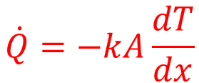




Modes of Heat Transfer (ME 320)
$$\dot{Q}→$$
Conduction
$$∆x$$
$$\dot{Q}=−kA\frac{dT}{dx}$$
Radiation
Convection
$$T_{f}$$
$$T_{w}$$
$$\dot{Q}=εσ({T_{H}}^{4}−{T_{L}}^{4})$$
$$\dot{Q}=hA(T_{w}−T_{f})$$
Notes:
In thermodynamics, we just say how much Q is going in.

Slide 12
Modes of Energy Transfer
Convective transport
Heat transfer
Work transfer
$$E=U+PE+KE$$
$$\frac{dE_{cv}}{dt}={\dot{Q}}_{cv}−{\dot{W}}_{cv}+\sum_{i}{{\dot{m}}_{i}}{\left(u+pe+ke+pv\right)}_{i}−\sum_{e}{{\dot{m}}_{e}}{\left(u+pe+ke+pv\right)}_{e}$$
$$\frac{dE_{cv}}{dt}={\dot{Q}}_{cv}−{\dot{W}}_{cv}+\sum_{i}{{\dot{m}}_{i}}{\left(h+\frac{V^{2}}{2}+gz\right)}_{i}−\sum_{e}{{\dot{m}}_{e}}{\left(h+\frac{V^{2}}{2}+gz\right)}_{e}$$
Enthalpy = internal energy + flow work
Notes:
Dump into enthalpy

Slide 13
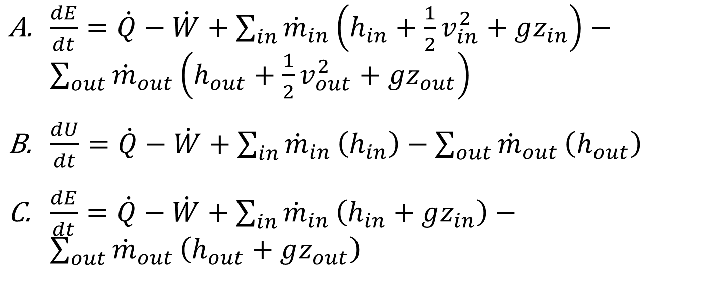
Modes of Energy Equation
How would the 1st law look if you were told that you could ignore the kinetic energy of any inlet and outlet streams?
$\frac{dE}{dt}=\dot{Q}−\dot{W}+\sum_{in}{{\dot{m}}_{in}}\left(h_{in}+\frac{1}{2}v_{in}^{2}+gz_{in}\right)−\sum_{out}{{\dot{m}}_{out}}\left(h_{out}+\frac{1}{2}v_{out}^{2}+gz_{out}\right)$
$\frac{dU}{dt}=\dot{Q}−\dot{W}+\sum_{in}{{\dot{m}}_{in}}\left(h_{in}\right)−\sum_{out}{{\dot{m}}_{out}}\left(h_{out}\right)$
$\frac{dE}{dt}=\dot{Q}−\dot{W}+\sum_{in}{{\dot{m}}_{in}}\left(h_{in}+gz_{in}\right)−\sum_{out}{{\dot{m}}_{out}}\left(h_{out}+gz_{out}\right)$
Notes:
1 minute

Slide 14



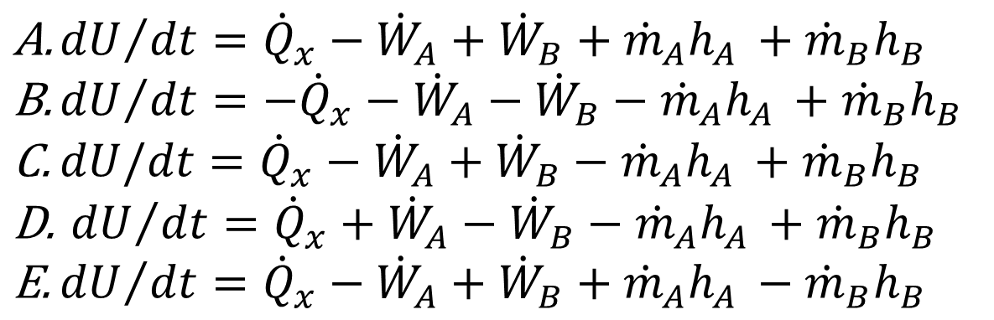
1st Law, Open System
Stream A
Ignore all KE & PE effects
$${\dot{W}}_{B}$$
$${\dot{Q}}_{x}$$
All variables are magnitudes.
$${\dot{W}}_{A}$$
Stream B
${dU}/{dt}={\dot{Q}}_{x}−{\dot{W}}_{A}+{\dot{W}}_{B}+{\dot{m}}_{A}h_{A }+{\dot{m}}_{B}h_{B }$
${dU}/{dt}={−\dot{Q}}_{x}−{\dot{W}}_{A}−{\dot{W}}_{B}−{\dot{m}}_{A}h_{A }+{\dot{m}}_{B}h_{B }$
${dU/dt=\dot{Q}}_{x}−{\dot{W}}_{A}+{\dot{W}}_{B}−{\dot{m}}_{A}h_{A }+{\dot{m}}_{B}h_{B }$
${ dU}/{dt}={\dot{Q}}_{x}+{\dot{W}}_{A}−{\dot{W}}_{B}−{\dot{m}}_{A}h_{A }+{\dot{m}}_{B}h_{B }$
${dU}/{dt}={\dot{Q}}_{x}−{\dot{W}}_{A}+{\dot{W}}_{B}+{\dot{m}}_{A}h_{A }−{\dot{m}}_{B}h_{B }$
Notes:
1 minute

Slide 15



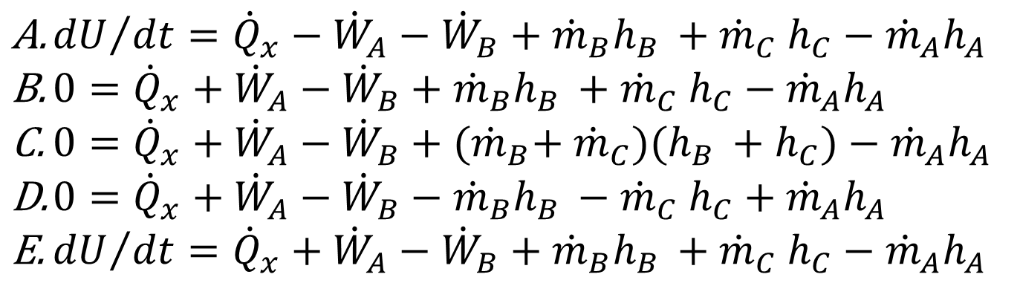
1st Law, Open System
Stream A
Ignore all KE & PE effects
Steady-state
Stream C
$${\dot{W}}_{B}$$
$${\dot{Q}}_{x}$$
All variables are magnitudes.
$${\dot{W}}_{A}$$
Stream B
${dU}/{dt}={\dot{Q}}_{x}−{\dot{W}}_{A}−{\dot{W}}_{B}+{\dot{m}}_{B}h_{B }{+ \dot{m}}_{C}h_{C}−{\dot{m}}_{A}h_{A }$
$0={\dot{Q}}_{x}+{\dot{W}}_{A}−{\dot{W}}_{B}+{\dot{m}}_{B}h_{B }{+ \dot{m}}_{C}h_{C}−{\dot{m}}_{A}h_{A }$
$0={\dot{Q}}_{x}+{\dot{W}}_{A}−{\dot{W}}_{B}+{(\dot{m}}_{B}{{+ \dot{m}}_{C})(h}_{B }+h_{C})−{\dot{m}}_{A}h_{A }$
$0={\dot{Q}}_{x}+{\dot{W}}_{A}−{\dot{W}}_{B}−{\dot{m}}_{B}h_{B }{− \dot{m}}_{C}h_{C}+{\dot{m}}_{A}h_{A }$
${dU}/{dt}={\dot{Q}}_{x}+{\dot{W}}_{A}−{\dot{W}}_{B}+{\dot{m}}_{B}h_{B }{+ \dot{m}}_{C}h_{C}−{\dot{m}}_{A}h_{A }$
Notes:
1 minute
B. Based on what we thinking…Q is positive, WA is negative,
E. Is the same though dU/dt
Steady state = left hand side = 0 = no change inside!

